Slide 1

Presentation Materials Created by Mimetics Inc.
Free use by anyone for non-commercial purposes
Copyrights, Trademarks and other Registered Marks the Property of their Owners

Slide 2
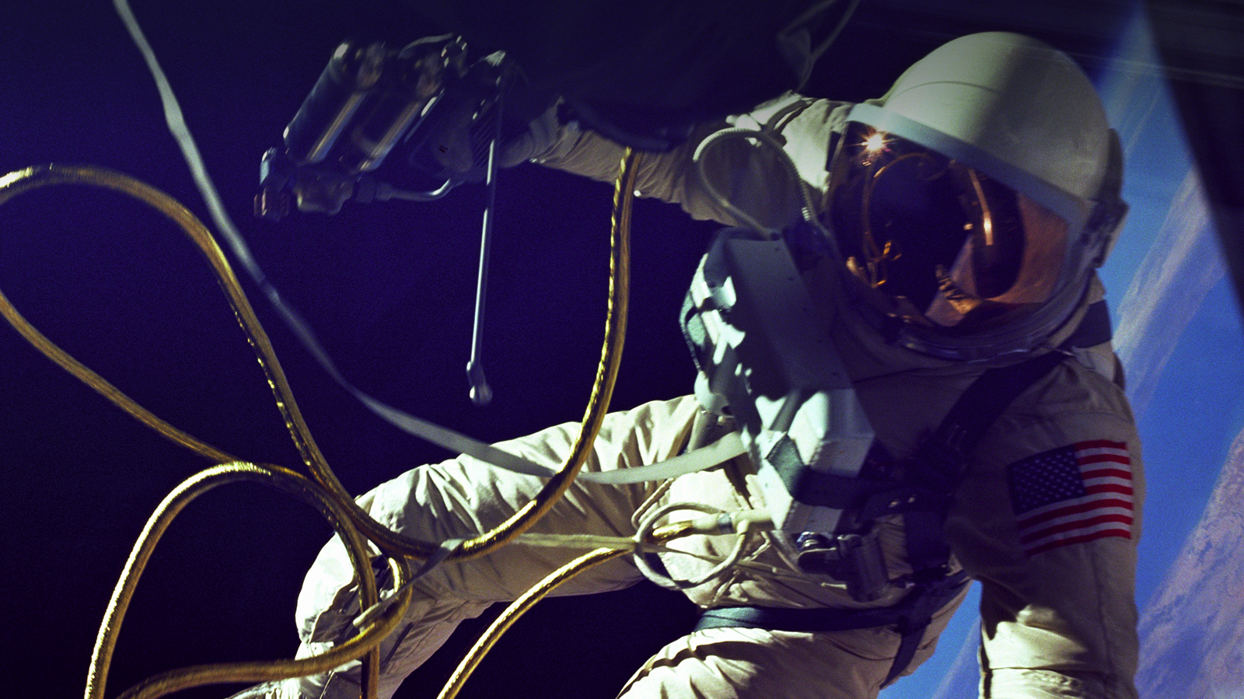
Survival in Space

Slide 3
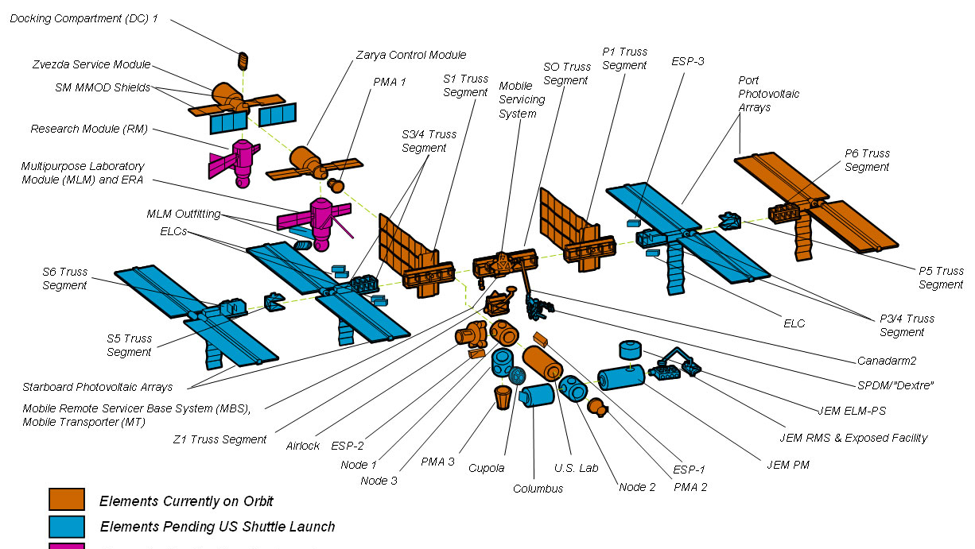
ISS Parts

Slide 4
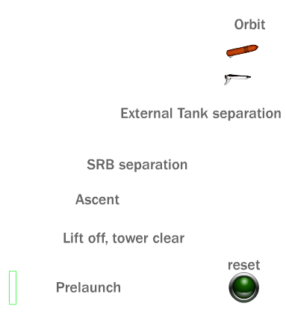
Shuttle to
Orbit
T = 10.5 Minutes – In Orbit
T = 9 Minutes – External Tank Separation
T = 2 Minutes – Boosters Separate
T = 1 Minute – Rockets at Full Power
T = 0 - Launch

Slide 5
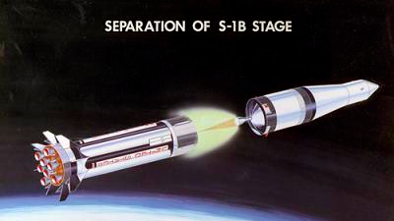
0.3% of the Cost of
A Rocket Flight is
Fuel

Slide 6

What Do We Need to Survive in Space

Slide 7
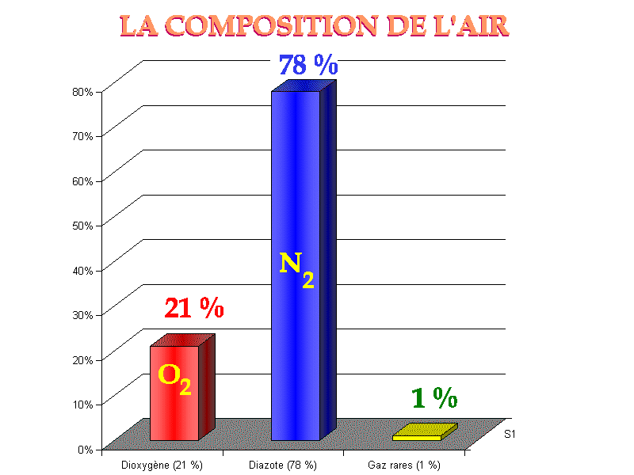
Air
What do we need from “Air” to Survive?

Slide 8
Air
What do we need from “Air” to Survive?
Just Oxygen
– 1/5th of Air at
Sea Level

Slide 9
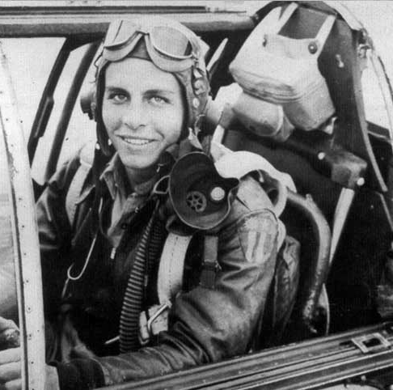
Oxygen Mask Increases Oxygen to Sea Level Amount
N2
59%
At 4,000m
Air Pressure
is ½ Sea Level
- Double Oxygen
O2
40%
Other ~ 1%

Slide 10
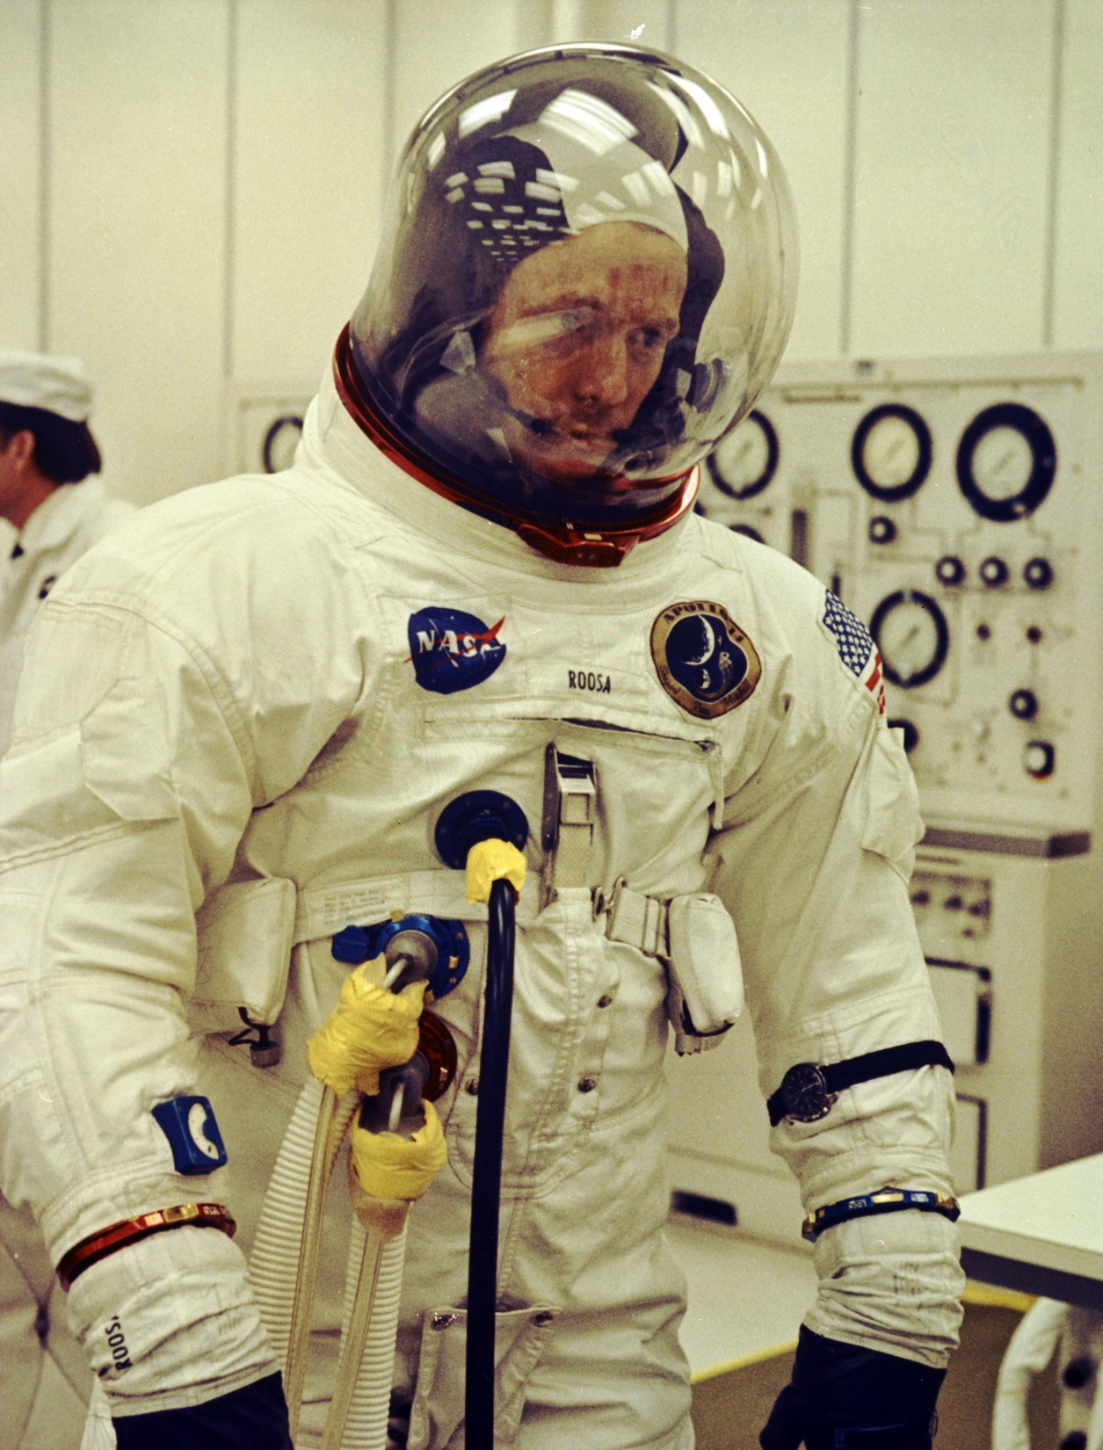
First Rocket Ships Used 100% Oxygen
O2
100%
Why did they do this?
N2 – 0%
Other ~ 0%

Slide 11
First Rocket Ships Used 100% Oxygen
O2
100%
Why did they do this?
To save weight; Less pressure means thinner (and lighter) Spacecraft walls
What Problems Were Encountered?
N2 – 0%
Other ~ 0%

Slide 12
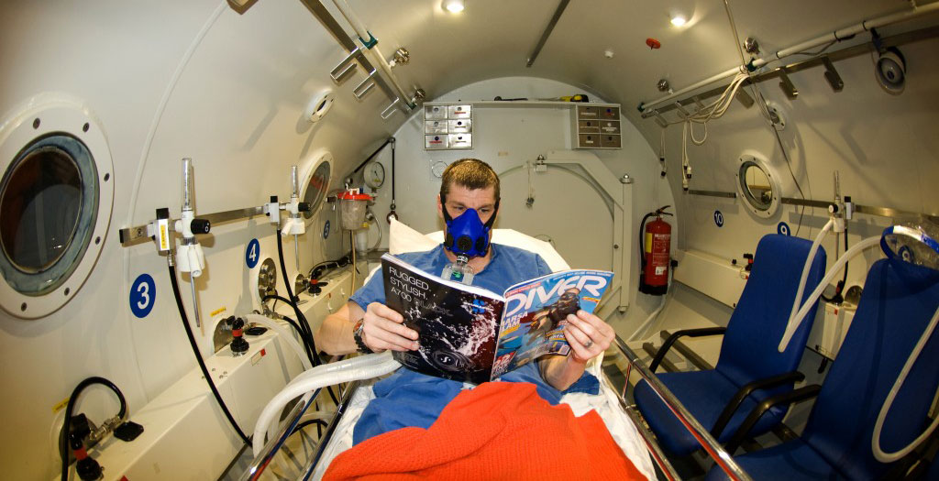
The Bends

Slide 13
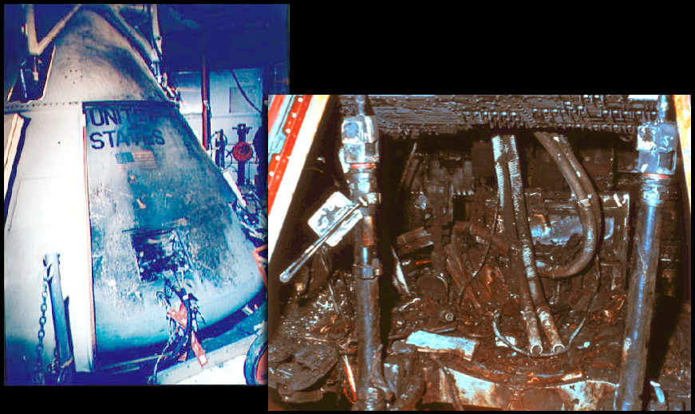
Fire

Slide 14
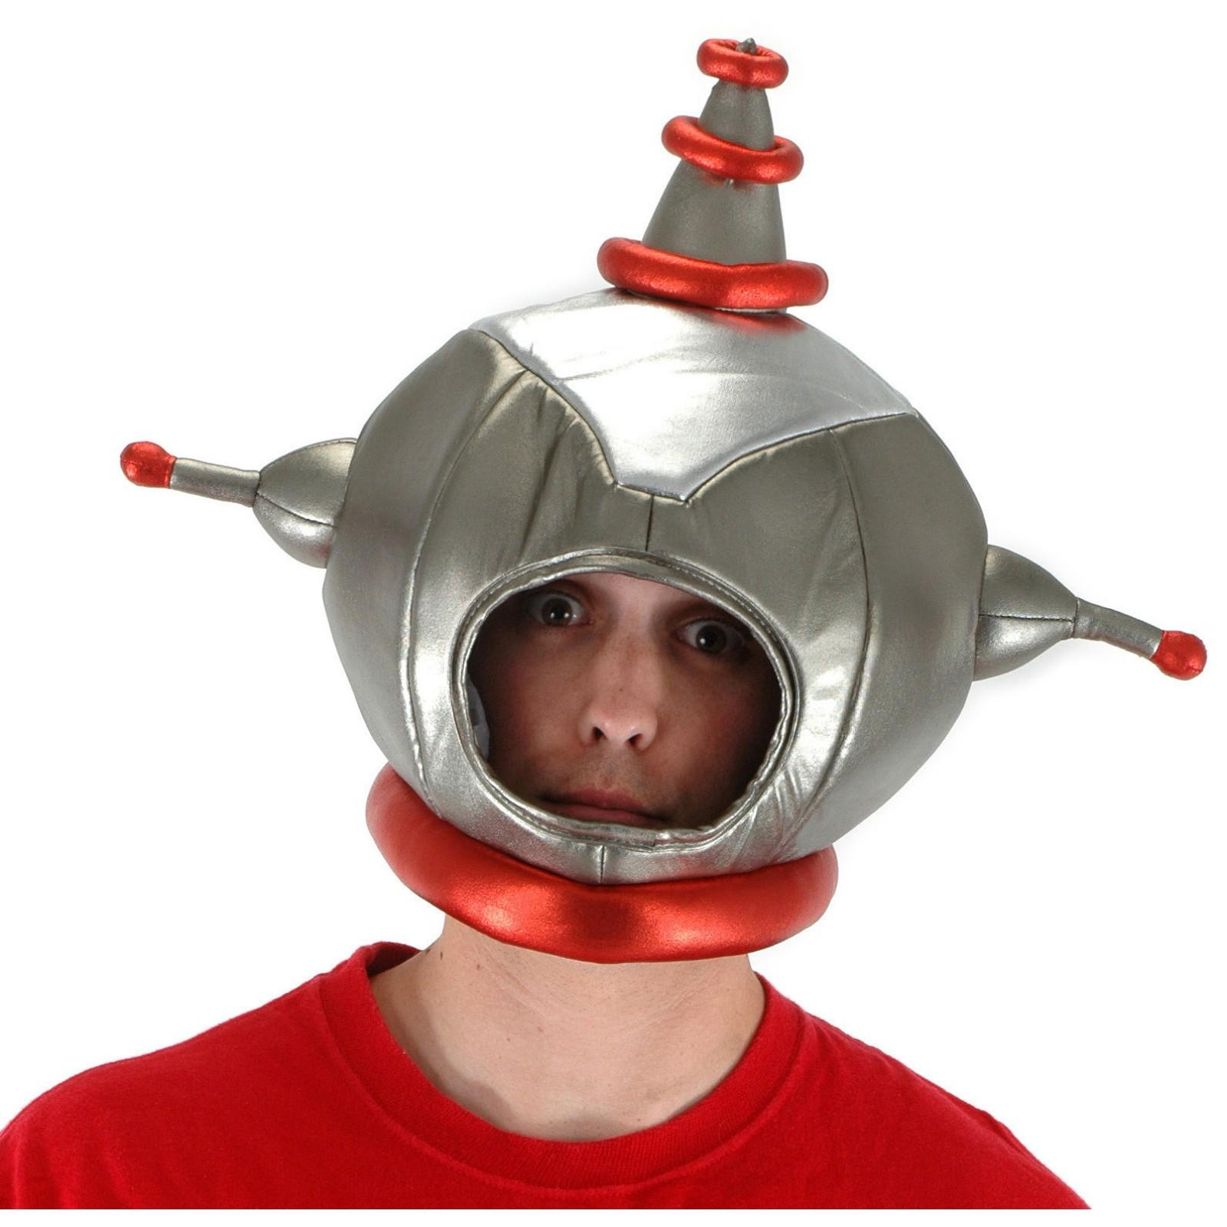
Is Oxygen all that’s Needed to Breathe?

Slide 15

If there is no air, can you drink using a straw?

Slide 16
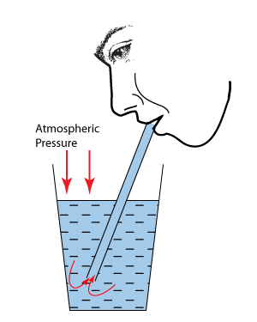
No, you are not “Sucking” the liquid

Slide 17
No, you are not “Sucking” the liquid
Pressure is needed so you can Breathe Properly

Slide 18
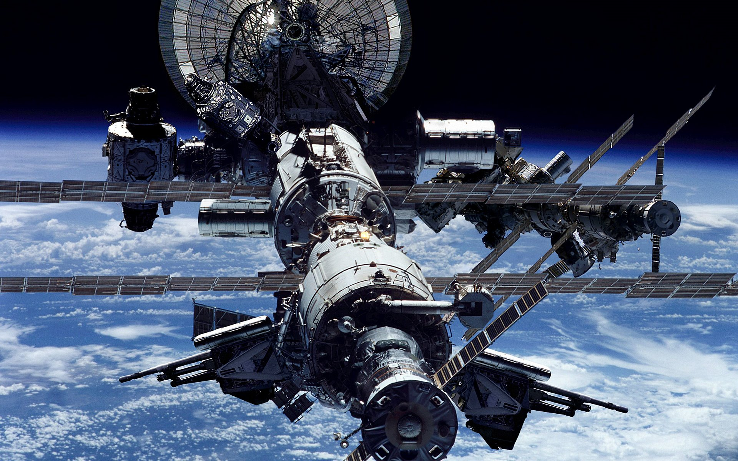
Temperature

Slide 19
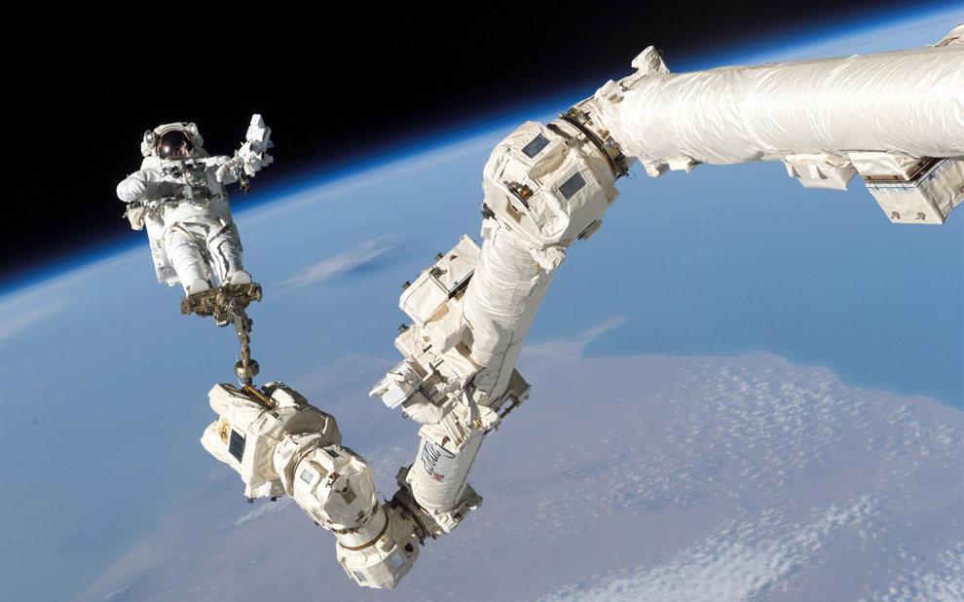
Sunlight Temperature
Can be 260C

Slide 20
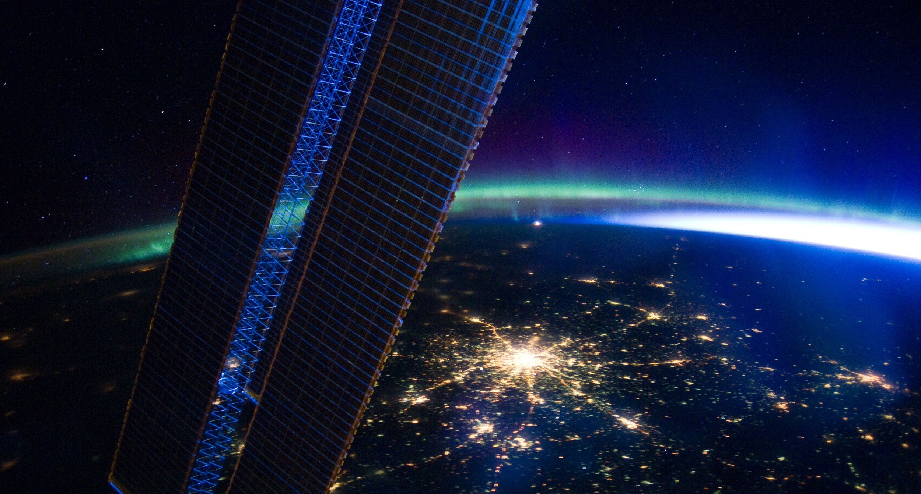
Darkness Temperature
Can be -130C

Slide 21
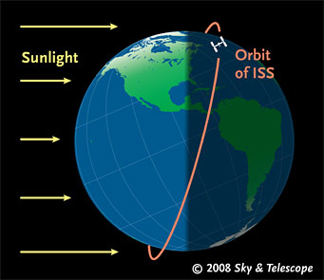
ISS Orbits the Earth Every 90 Minutes
Sunlight & Darkness 16 Times/Day

Slide 22
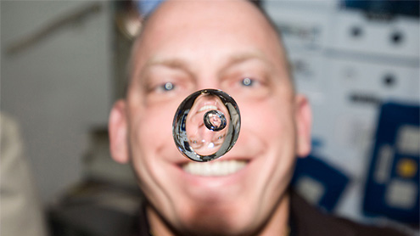
If water floats
in Space,
How do you
Drink it?

Slide 23
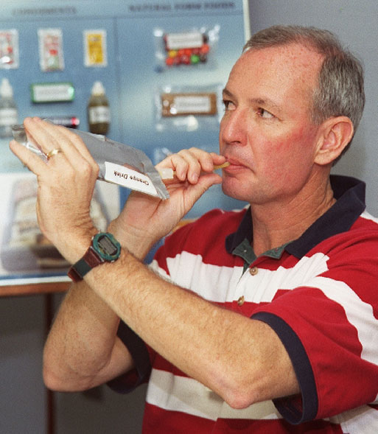
Where does this Water come from?

Slide 24
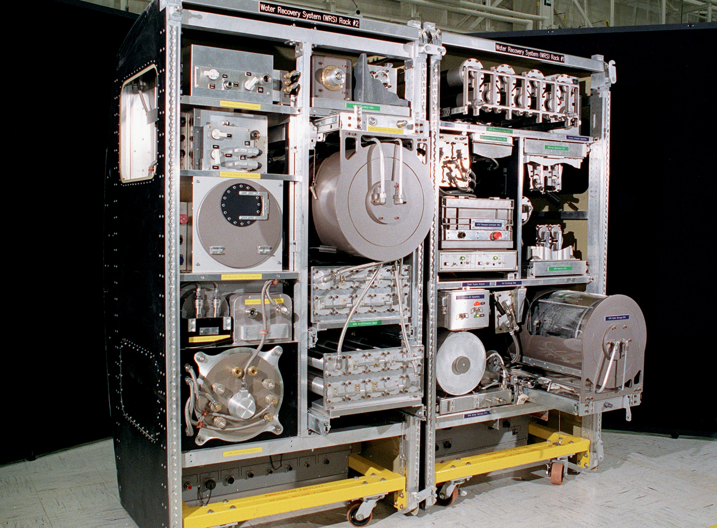
ISS Water Recycling System
Where does the water that is “Rycycled” come from?

Slide 25
ISS Water Recycling System
Water Loss:
50% Sweat
30% Breath
20% Urine

Slide 26
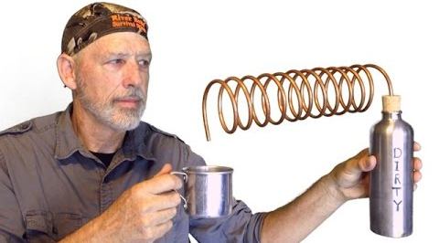
Boil “Dirty” Water to Make Steam
Condense Clean H2O

Slide 27
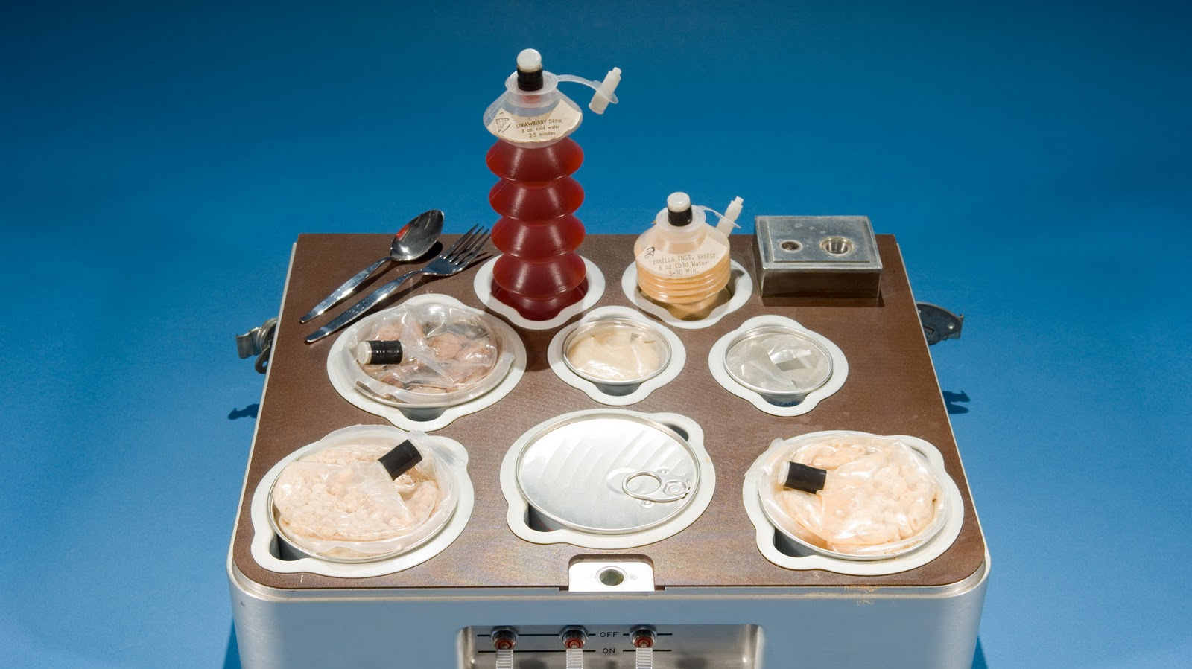
Food

Slide 28
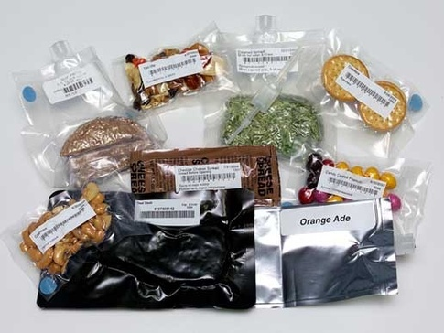
Astronauts need the same number of Calories in Space as on Earth but…

Slide 29
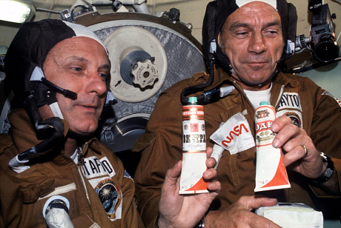
Astronauts Lose Their Sense of Smell and Taste in Space
They Want Spicy Food!

Slide 30
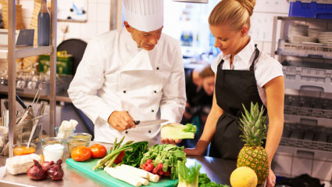
Food Preparation is Impossible with NO GRAVITY

Slide 31
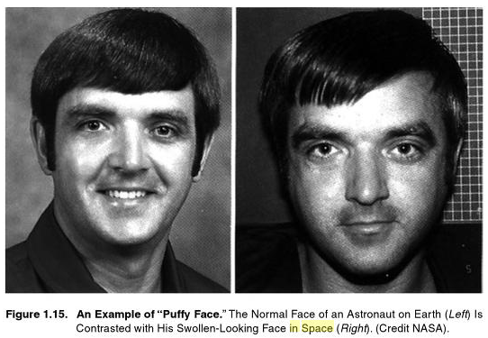
Gravity

Slide 32
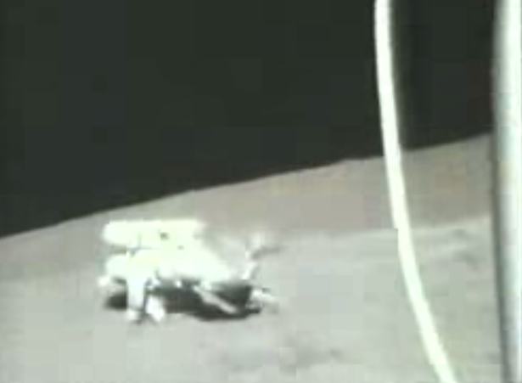
Humans need 20 – 30% Earth Gravity to Move Efficiently

Slide 33
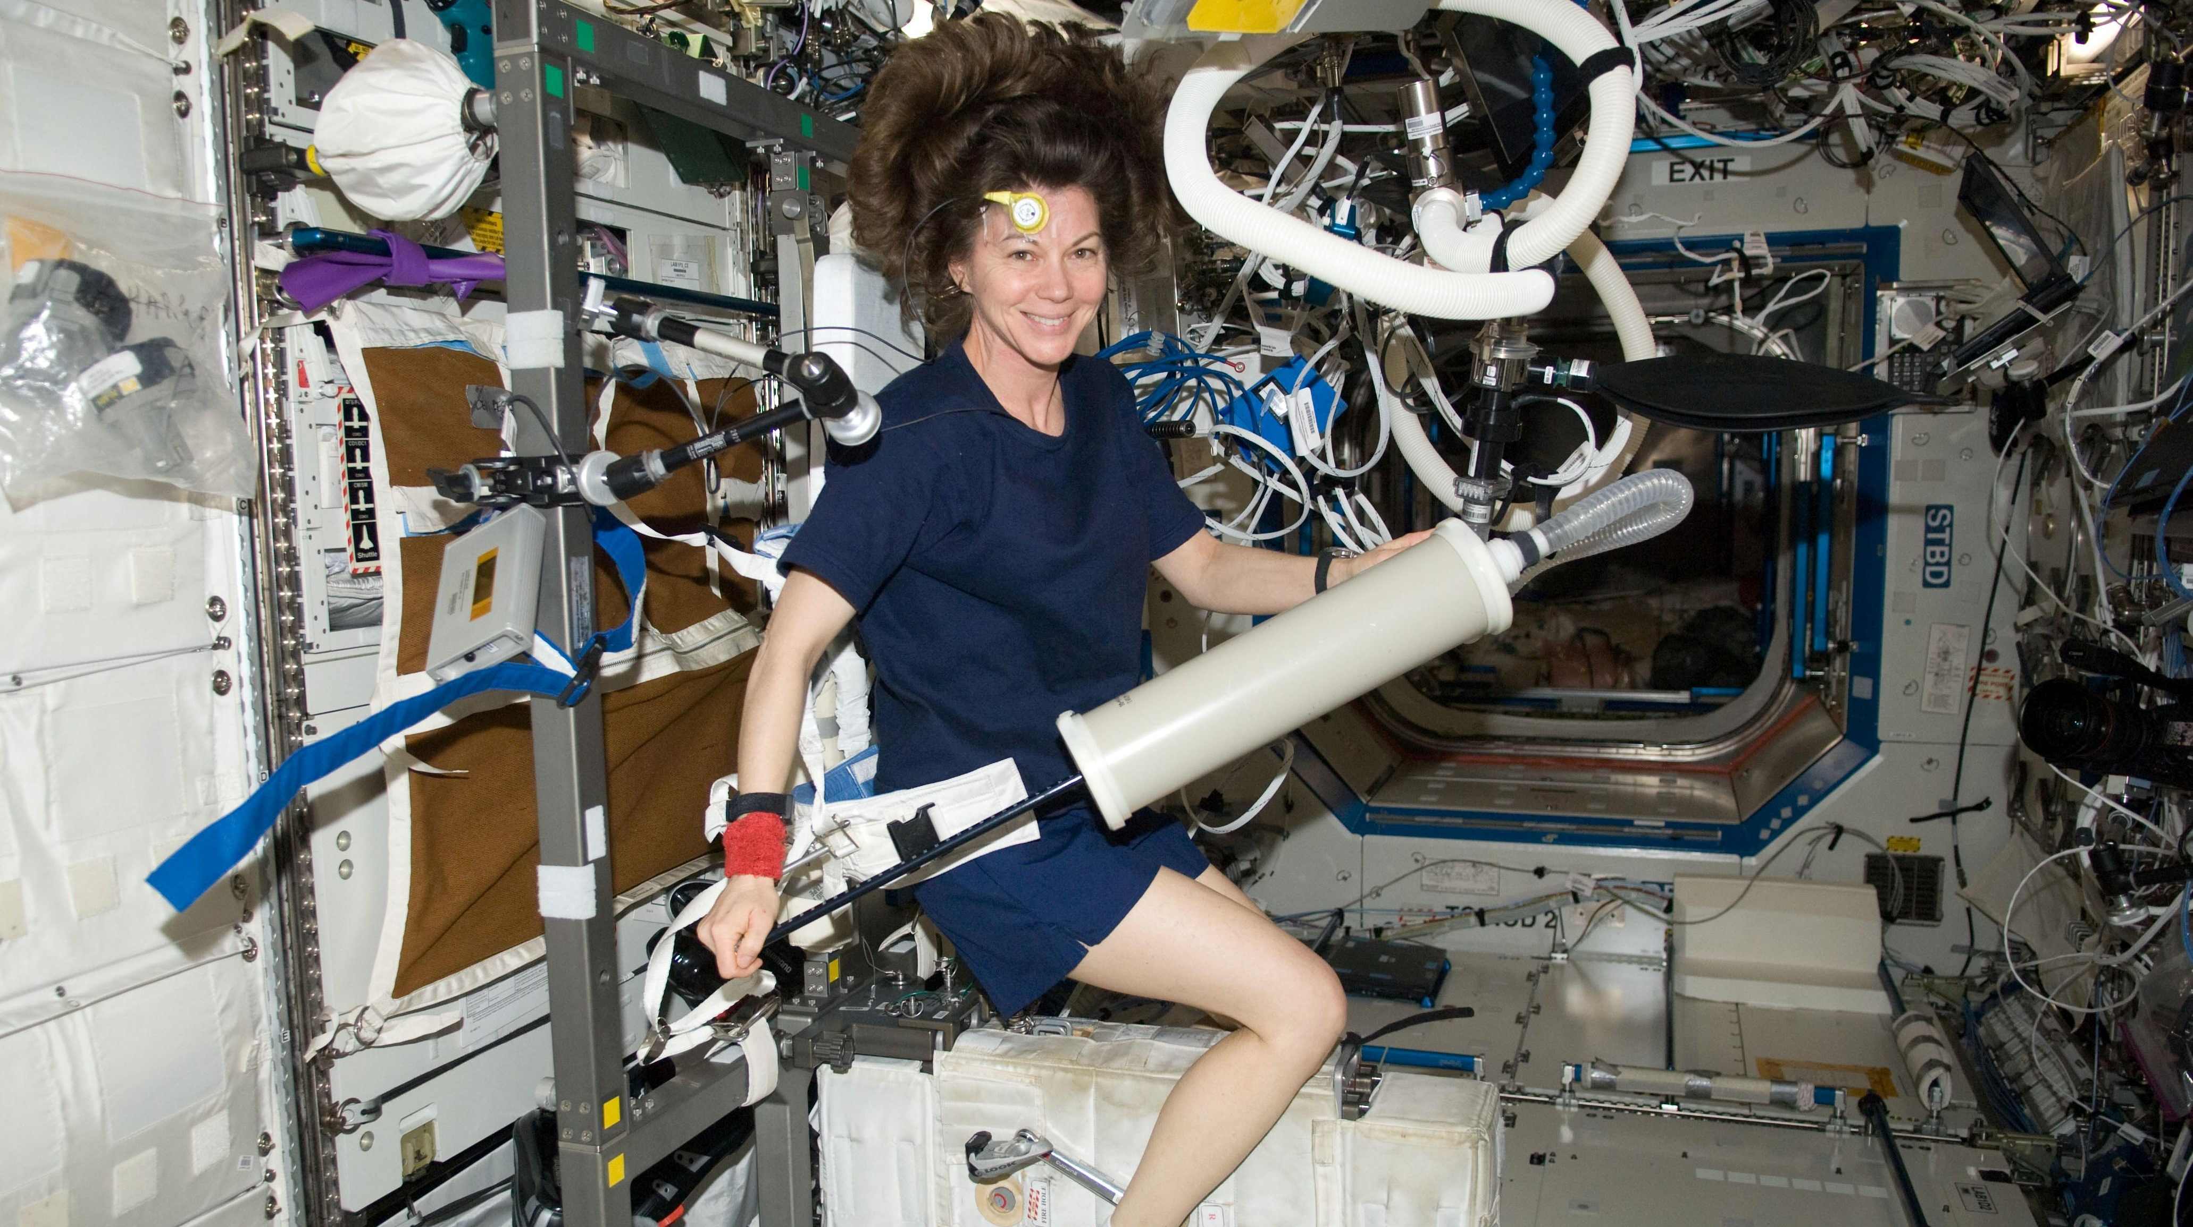
Astronauts Exercise 2.5 Hours Per Day to Stay Healthy

Slide 34
Problems Astronauts Get In/From Weightlessness:
High Blood Pressure
Space Sickness
Lower Red Blood Cell Count
Compromised Immune System
Back Aches
Muscle Loss
Vision Problems
Body Odor (Difficult to wash)
Poor Balance & Orientation

Slide 35
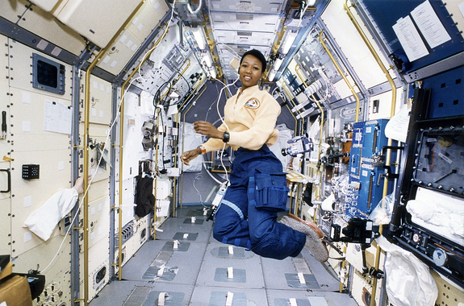
Oxygen
Pressure
Temperature
Water
Food
Gravity

